Slide 1

Credit Card - Fraud Prediction
Vinay Nagaraj & Vikas Ranjan
DSC630, Spring 2021
Bellevue University, NE

Slide 2
Problem Statement
Credit card is the most used payment method in the world. In 2020, 38 percent of point of sale payments being made by credit card in USA. Using a debit card was the second most common payment method, followed by cash.
Credit cards and electronic payments make overall functioning in a global marketplace much easier.
Credit card fraud was ranked number one type of identity theft fraud. Each year financial institutions lose a significant amount of money as a result of credit card fraud.
Credit card frauds are easy and friendly targets. E-commerce and many other online sites have increased the online payment modes, increasing the risk for online frauds. Increase in fraud rates, researchers have started using different machine learning methods to detect and analyze frauds in online transactions.

Slide 3
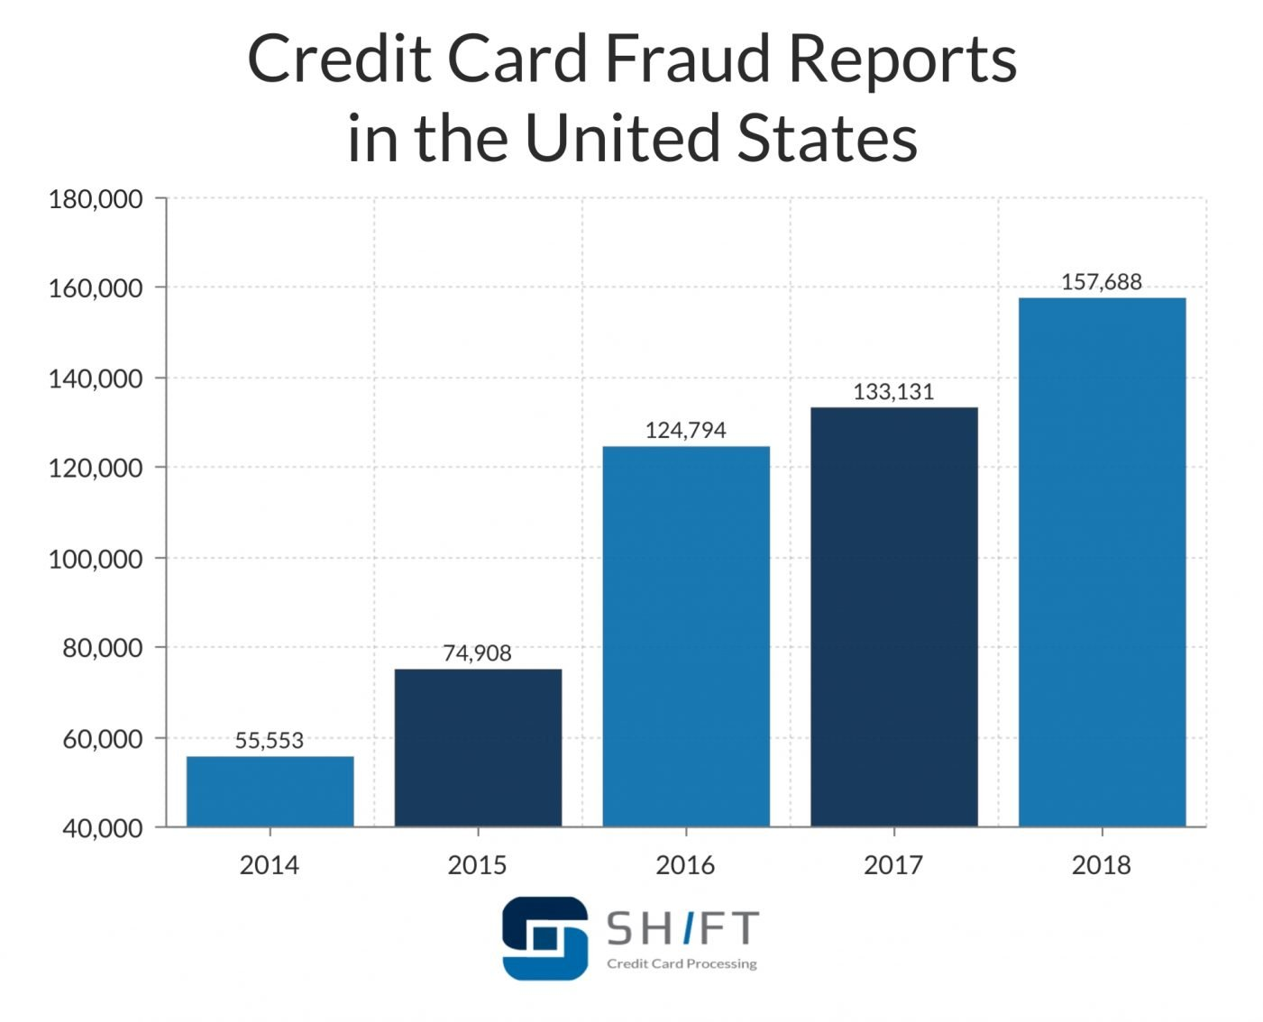
Credit Card Fraud Statistics
In year 2018, a total of $24.26 Billion was lost due to payment card fraud across the globe and United States being the most fraud prone country.
Credit card fraud increased by 18.4 percent in 2018 and is still climbing.
Credit card companies have developed extremely sophisticated tools for detecting fraud.

Slide 4
Proposal
Machine learning algorithms to predict if credit card transaction is fraudulent or non-fraudulent.
Train and test models.
Compare model performance and select the best model.

Slide 5
Process Overview
Preliminary analysis on data
Data preparation and cleaning for any missing values.
Perform Exploratory Data Analysis
Train and test models
Model evaluation and tuning

Slide 6
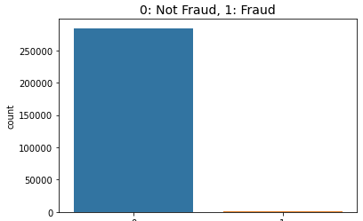
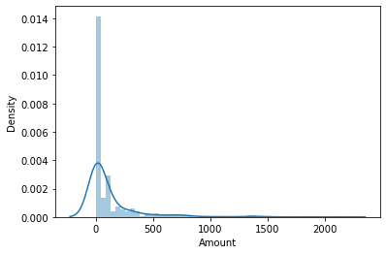
Dataset Overview
The datasets we have chosen for our work contains transactions made by credit cards in September 2013 by European cardholders. This dataset presents transactions that occurred in two days, where we have 492 frauds out of 284,807 transactions.
Most of the fraudulent transactions are of small amounts. Fraudsters know that small credit transactions often go unnoticed.

Slide 7
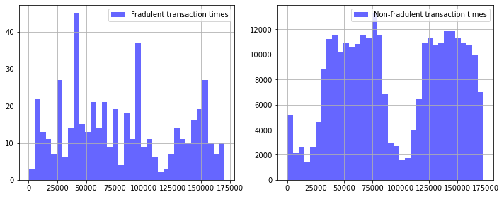
Transaction times
There is no set time frame in a day when Fraudulent transactions occur. They are spread throughout the day.
This makes Transaction time not one of the important features we can use for our model to determine if a particular transaction is fraudulent or not.

Slide 8
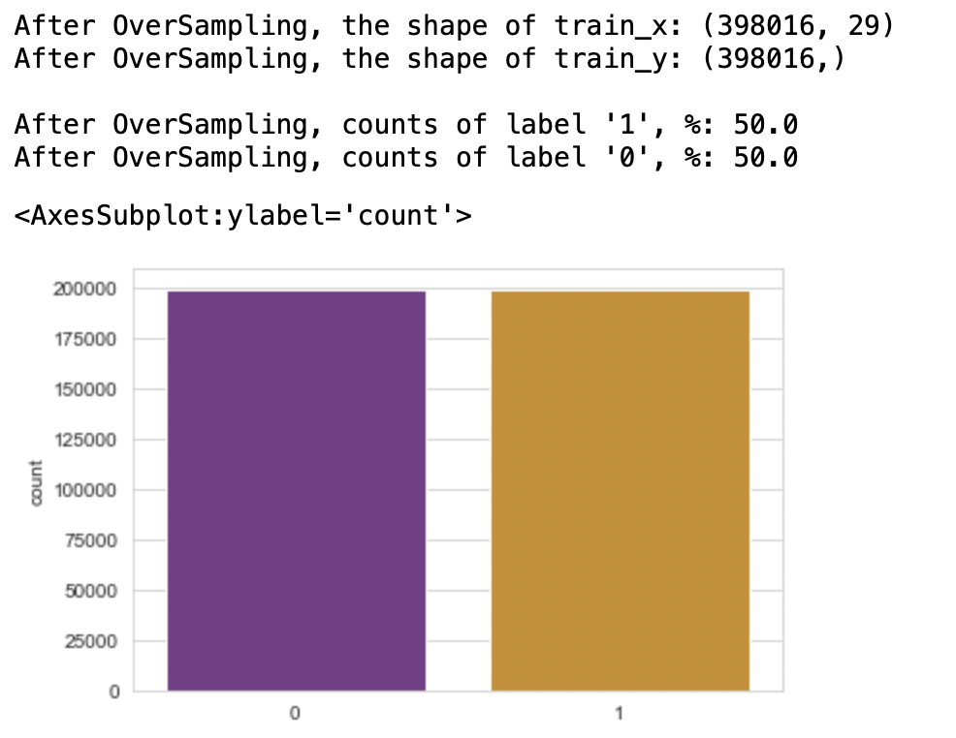
SMOTE – Oversampling
Our dataset is highly imbalanced as most of the transactions are non-fraudulent. To address this challenge, we are implementing oversampling.
Oversampling increases the number of minority class members in the training set.
We are using oversampling technique called SMOTE (Synthetic Minority Oversampling Technique), to make our dataset balanced. It creates synthetic points from the minority class.

Slide 9
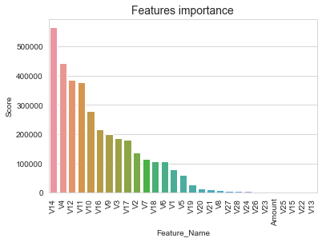
Feature Importance
Feature importance is a technique that assign a score to input features based on how useful they area predicting a target variable.
In this dataset our predicting target variable is “Class” which determines if a transaction is fraudulent or not.
We have used the SelectKBest technique to identify most relevant features for selection in order of importance in our work.

Slide 10
Classification Models - Comparison
The table here shows an aggregate measure of performance across the 4 classification models that we choose. We have used our training dataset to compute this score.
We choose to use RandomForest and Logistic Regression model due to their accuracy scores.
The hyper parameters are tuned for the model using Gridsearch to evaluate the performance.

Slide 11
Random Forest Model
Based on a high roc_auc value, Random Forest Model provides us a high true prediction values for our dataset.
We tested this model on the test dataset.
This model has an AUROC of 0.98528 which means that the model has very good discriminatory ability.
98.528% of the time, our model will correctly predict if the transaction was fraudulent or not.

Slide 12
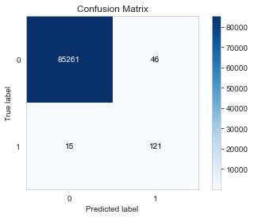
Random Forest Model – Confusion Matrix
85261 cases are true negative, meaning they are non fraudulent transactions and model predicted them as non-fraudulent.
121 transactions are true positive, meaning they were predicted as fraudulent and are actually fraudulent ones.
15 instances are false negative and 46 are false positives.

Slide 13
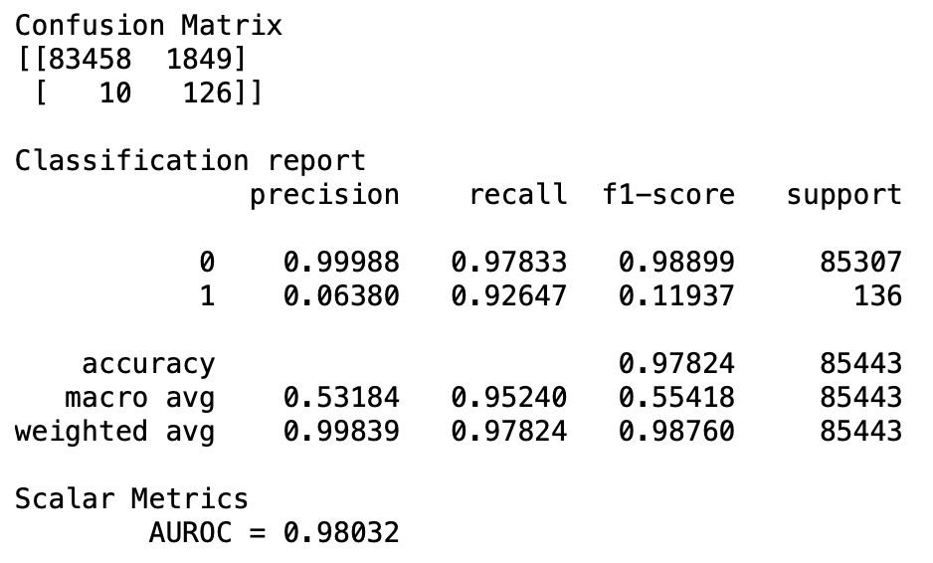
Logistic Regression Model
Logistic regression is another classification model with high roc_auc value.
We tested this model with the test dataset.
This model has an AUROC of 0.98032 which means that the model has very good discriminatory ability.
98.032% of the time, our model will correctly predict if the transaction was fraudulent or not.

Slide 14
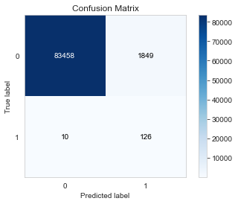
Logistic Regression Model – Confusion Matrix
83458 cases are true negative, meaning they are non fraudulent transactions and model predicted them as non-fraudulent.
126 transactions are true positive, meaning they were predicted as fraudulent and are actually fraudulent ones.
10 instances are false negative and 1849 are false positives.

Slide 15
Conclusion
Transaction time does not have any influence on prediction of fraudulent transaction. This was proven by SelectKBest.
SMOTE oversampling technique helped overcome the Imbalanced datasets challenge.
Based on comparison of confusion matrix of classification models, we recommend that Random forest classification would be a better performing model to predict whether a transaction is fraudulent or not.
Random forest model has less false positives than logistic regression.

Slide 16
References
ULB, M. (2018, March 23). Credit card fraud detection. Retrieved March 27, 2021, from https://www.kaggle.com/mlg-ulb/creditcardfraud
Credit card Fraud Statistics. (2021, January 04). Retrieved March 27, 2021, from https://shiftprocessing.com/credit-card-fraud-statistics/
Siegel, E. (2016). Predictive analytics: The power to predict who will click, buy, lie, or die. Hoboken, NJ: Wiley.

